Slide 1


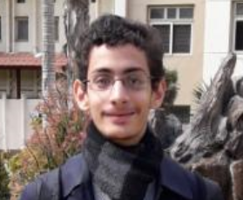
(summoner) | (thief) | (witcher)
Hp 5 Dmg 3 Points 0 Abilities: Summon Goblin Summon Golem (3/3) Barrier (5/5) Your Choice of spell | Hp 7 Dmg 15 Points 0 Abilities: Backstab Vanish Steal Item Your Choice of Action | Hp 10 Dmg 10 Points 0 Abilities: Normal stab Shield? Fireball (5/5) Sniffa Your Choice of Action/spell

Slide 2
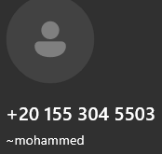
(summoner) | (thief) | (witcher) | (some guy idk)
Points 0 Money 3$ Is wide | Points 0 Money 3$ Zebo manga (allegedly) | Points 0 Money 3$ Kicks saifs ass (AlLeGgEdLy) | Points Money 3$ Has a Magic Stick

Slide 3
geography | logic | anatomy | fantasy | Quantum physics and relativity
100 | 100 | 100 | 100 | 100
 | 200 | 200 | 200 | 200
300 | 300 | 300 | 300 | 300
400 | 400 | 400 |  | 400
500 | 500 | 500 | 500 | 500
600 | 600 | 600 | 600 | 600
700 | 700 | 700 | 70 | 700
200
400

Slide 4

Good Wheel
Shadow realm
NUCLEAR BOMB
Money +1
Bad wheel
Start
Shadow realm
POINTS
+200
Shop
Shadow realm

Slide 5
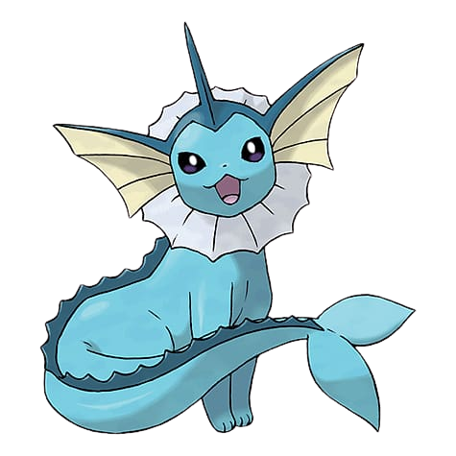
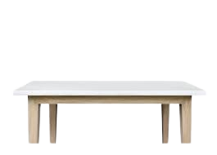
3$
1000 points
???$
10$
7$
5$
5$
10$

Slide 6
How many holes are in the word Polo

Slide 7
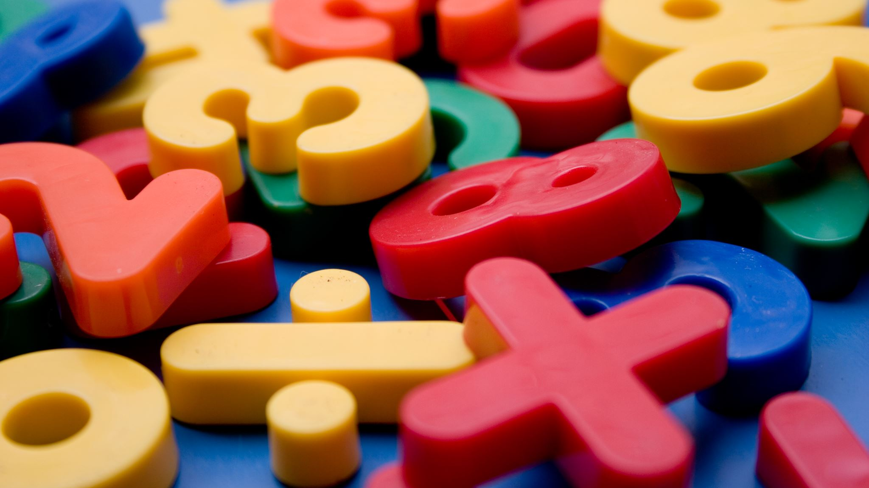
Four

Slide 8
Name a big number

Slide 9
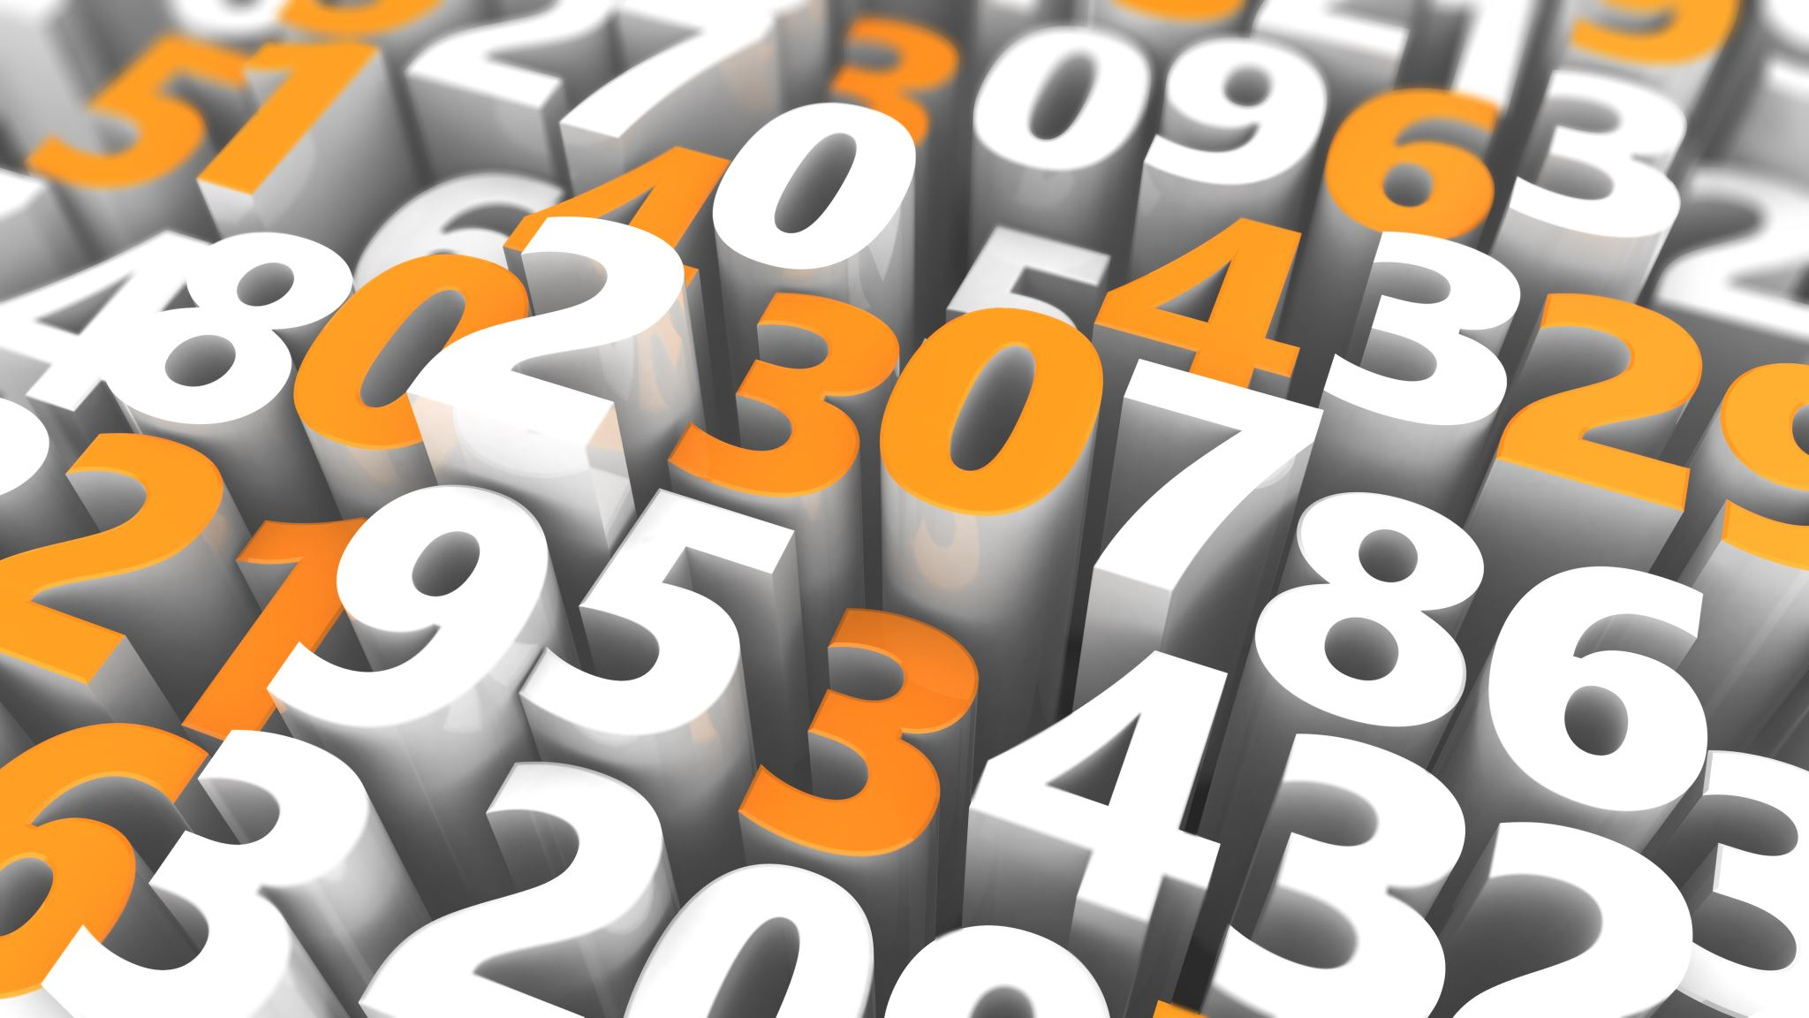
Any number greater than trillion

Slide 10
Within 10 decimal points how
many solar luminosities is the sun

Slide 11
1

Slide 12
icecream sandwitch

Slide 13
icecream Sandwitch

Slide 14
Which is stronger? magnets or Gravity?

Slide 15

Magnets

Slide 16
this is the protagonist of a movie about a cat who is fighting for a wish to bring back its lost lives

Slide 17
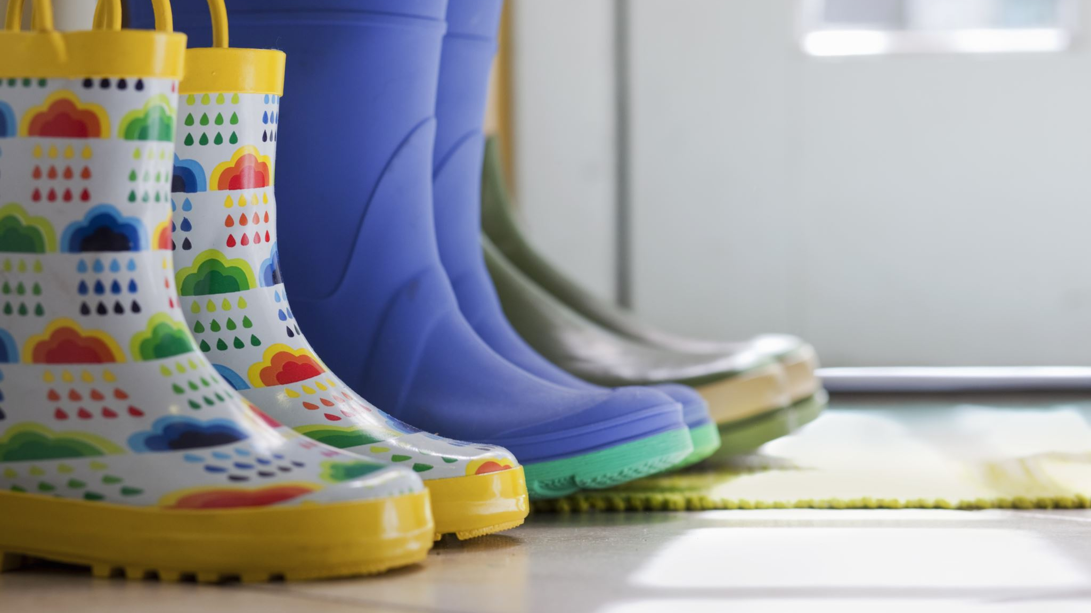
Puss in boots 2

Slide 18
What rough estimation is commonly used for the speed of light

Slide 19
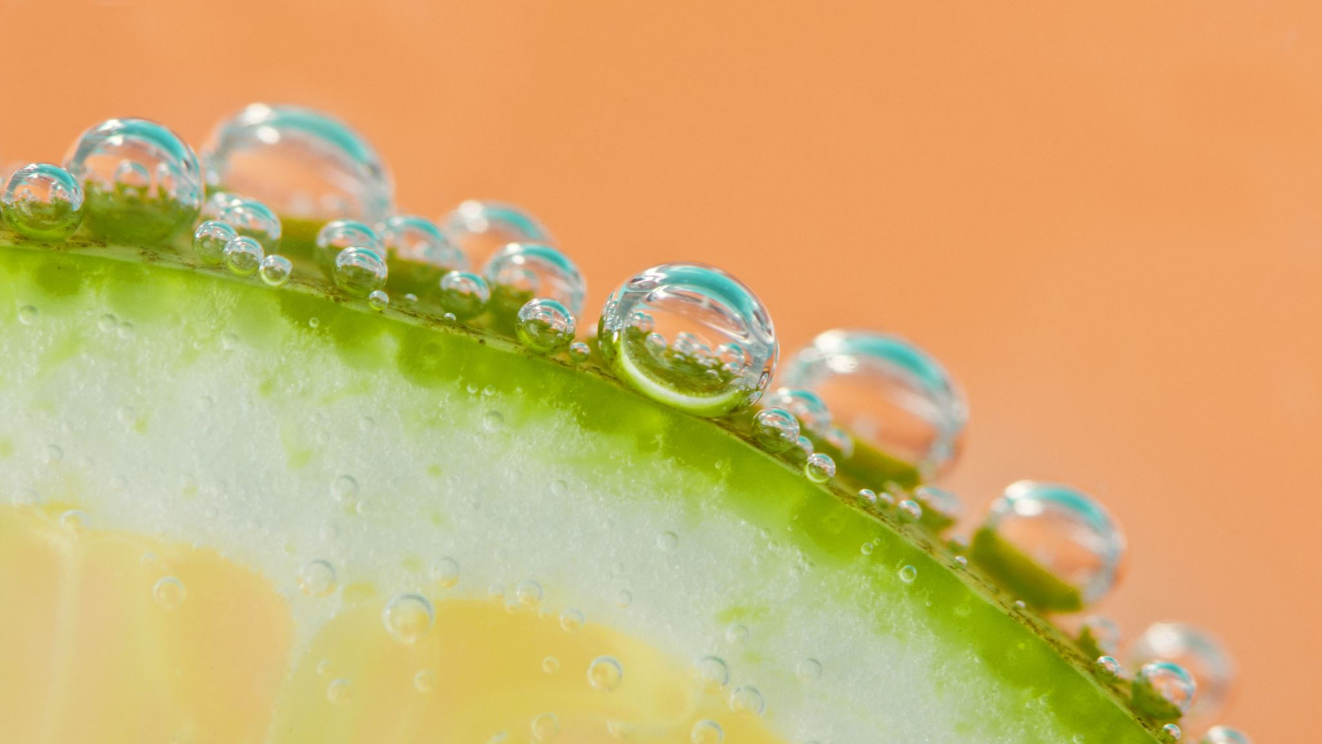
C

Slide 20

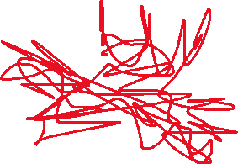

Slide 21
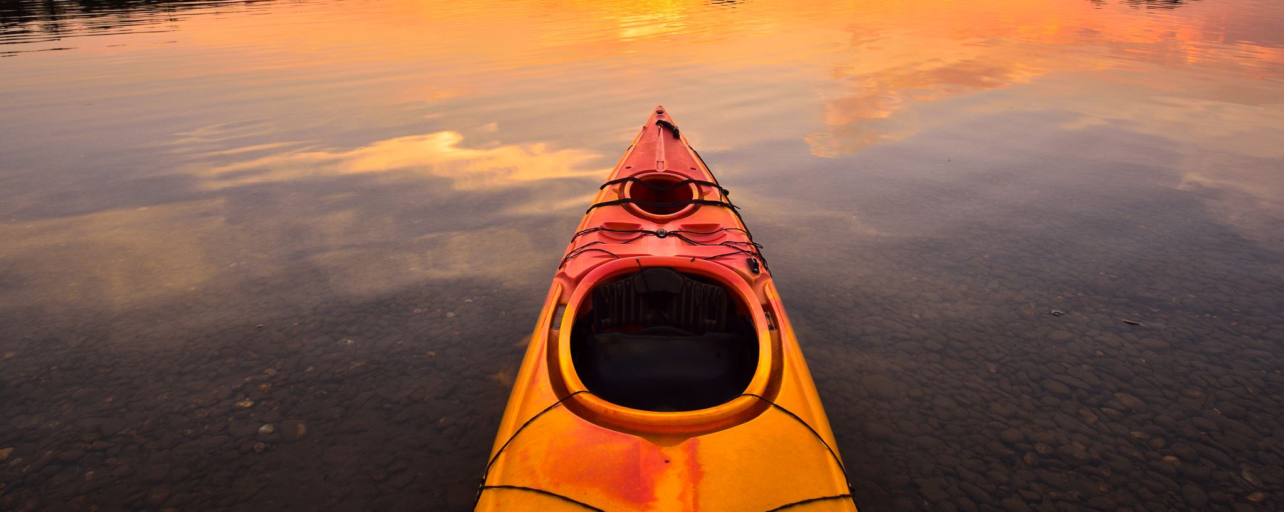
Canada!

Slide 22
More than 75% of the earth's surface is covered in this

Slide 23
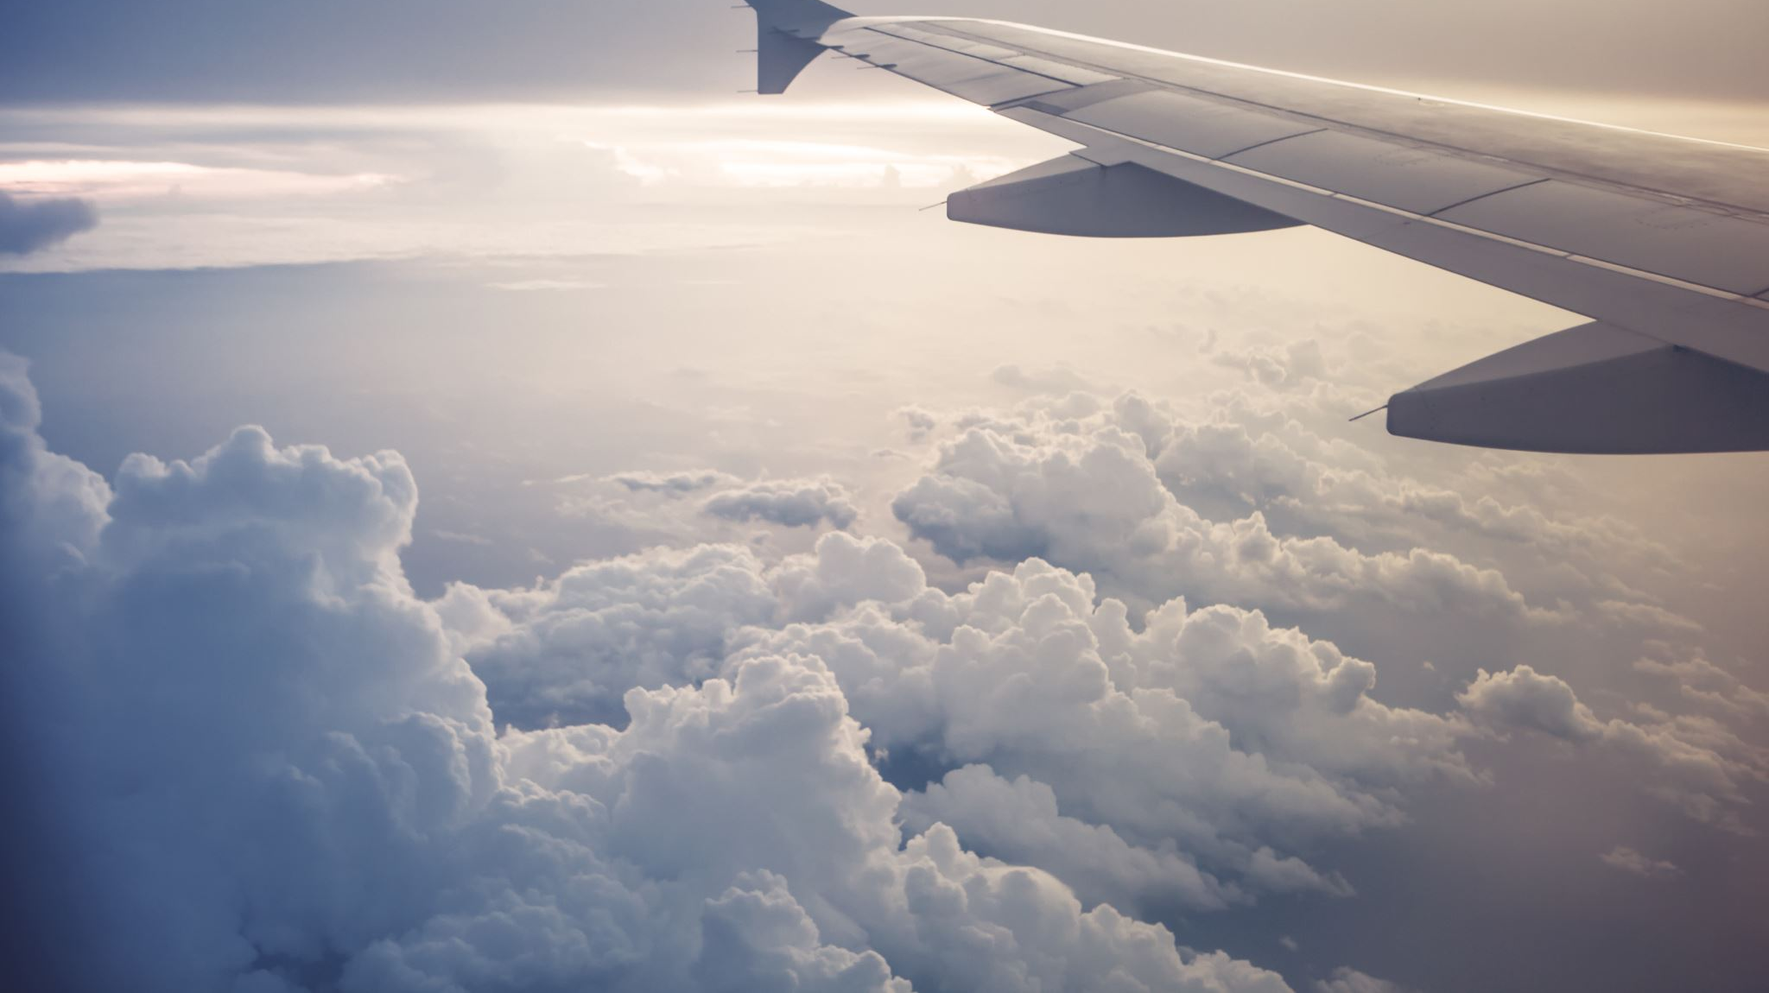
Air

Slide 24
What is the name of the 7 continents before the splitting?

Slide 25
Pangaea

Slide 26
What do people in greenland speak?

Slide 27
Greenlandish

Slide 28
Despite what many people may believe this is the real tallest mountian in the world

Slide 29
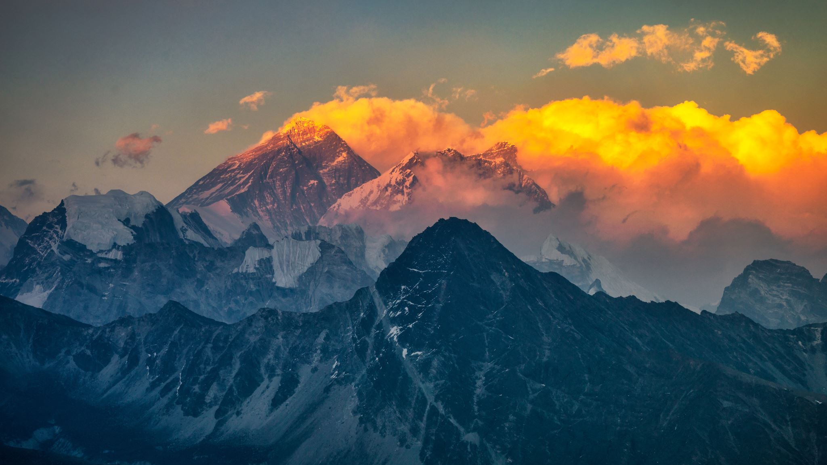
Mt.Everest

Slide 30
Where is Tokyo tower located?

Slide 31
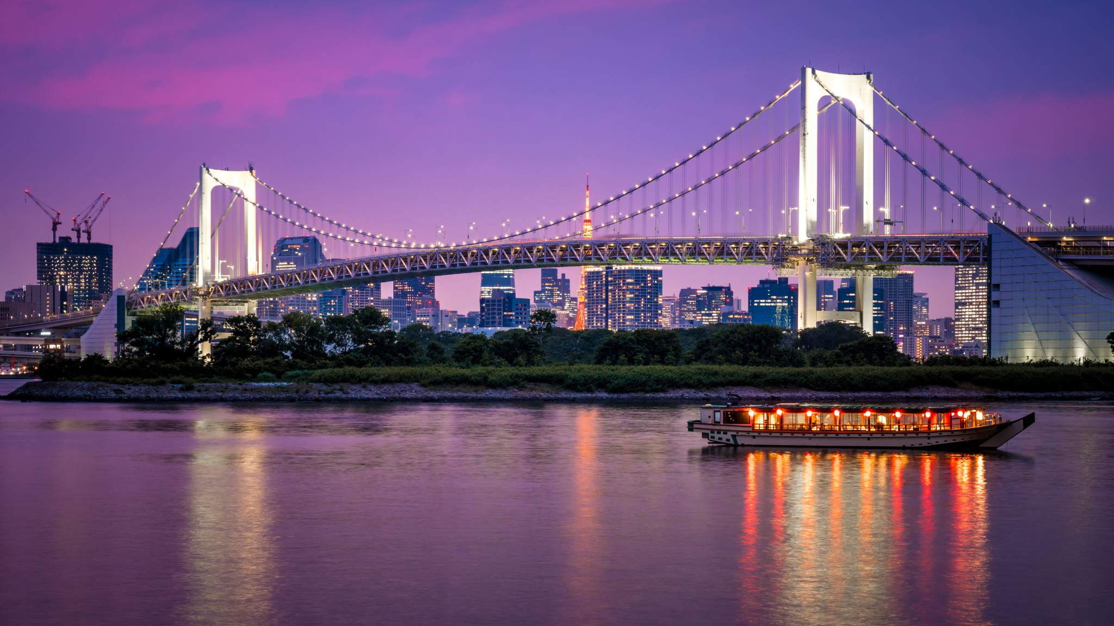
Tokyo

Slide 32
This country is located north of south korea

Slide 33

North Korea

Slide 34
True or False

Slide 35
False

Slide 36
john has 10 candles each candle can burn for 10 minutes john then lights all of his candles. How long will the candles burn for?

Slide 37
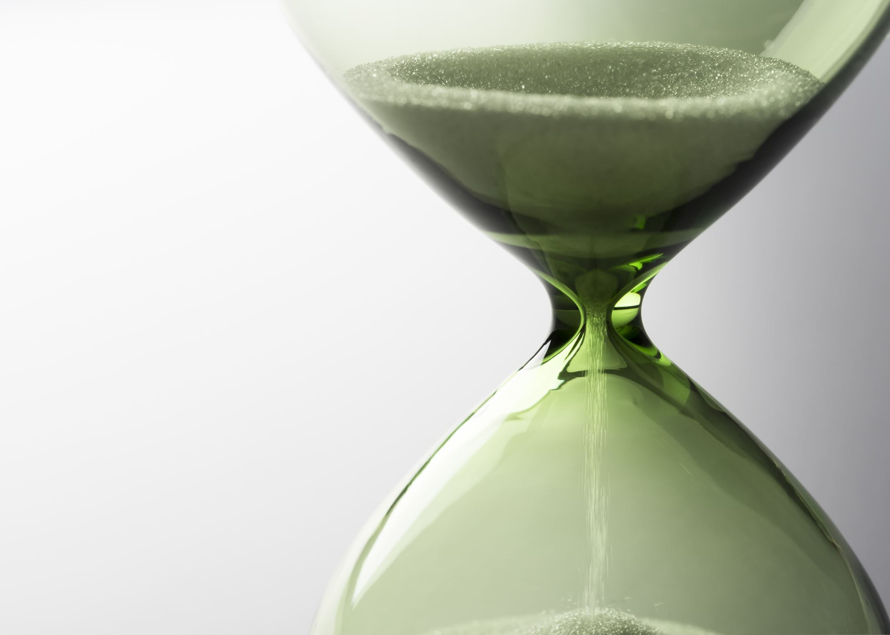
100 minutes

Slide 38
Did u answer this question right?

Slide 39
whenever A is true B is always true. If A is false what do we know about B

Slide 40
Nothing

Slide 41
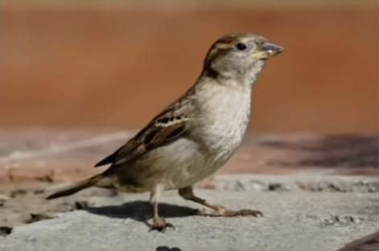
What is this

Slide 42
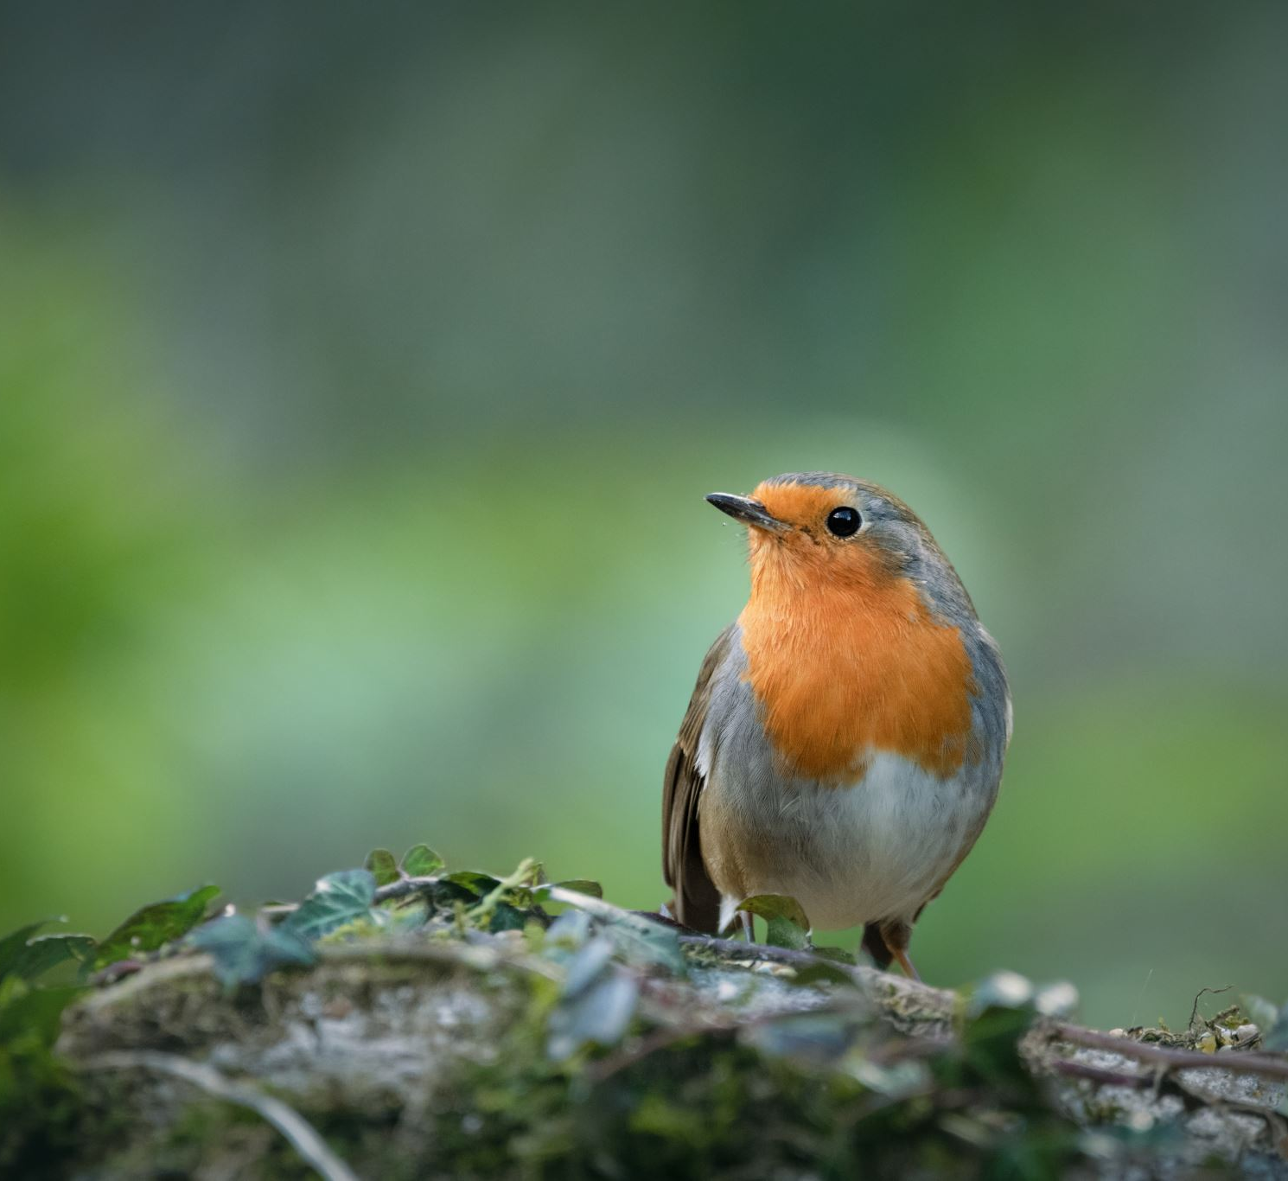
It is a bird

Slide 43
How much was 1 le worth in 1976

Slide 44
1 le

Slide 45
What is the least common answer to the question pick a number randomly between 1-10

Slide 46
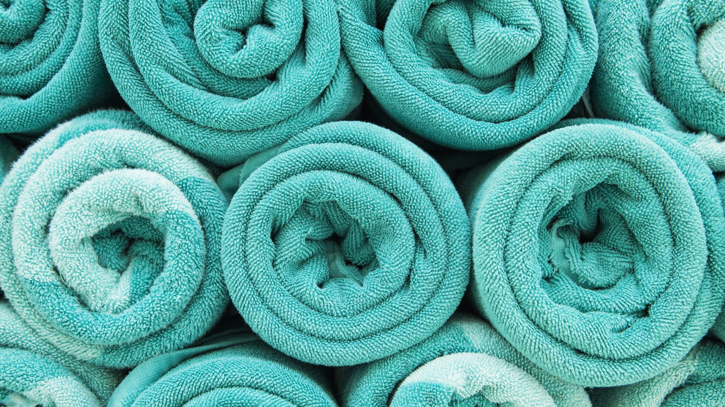
10

Slide 47
True or False (explain your answer) there is a hole located in your heart that you couldn't live without.

Slide 48
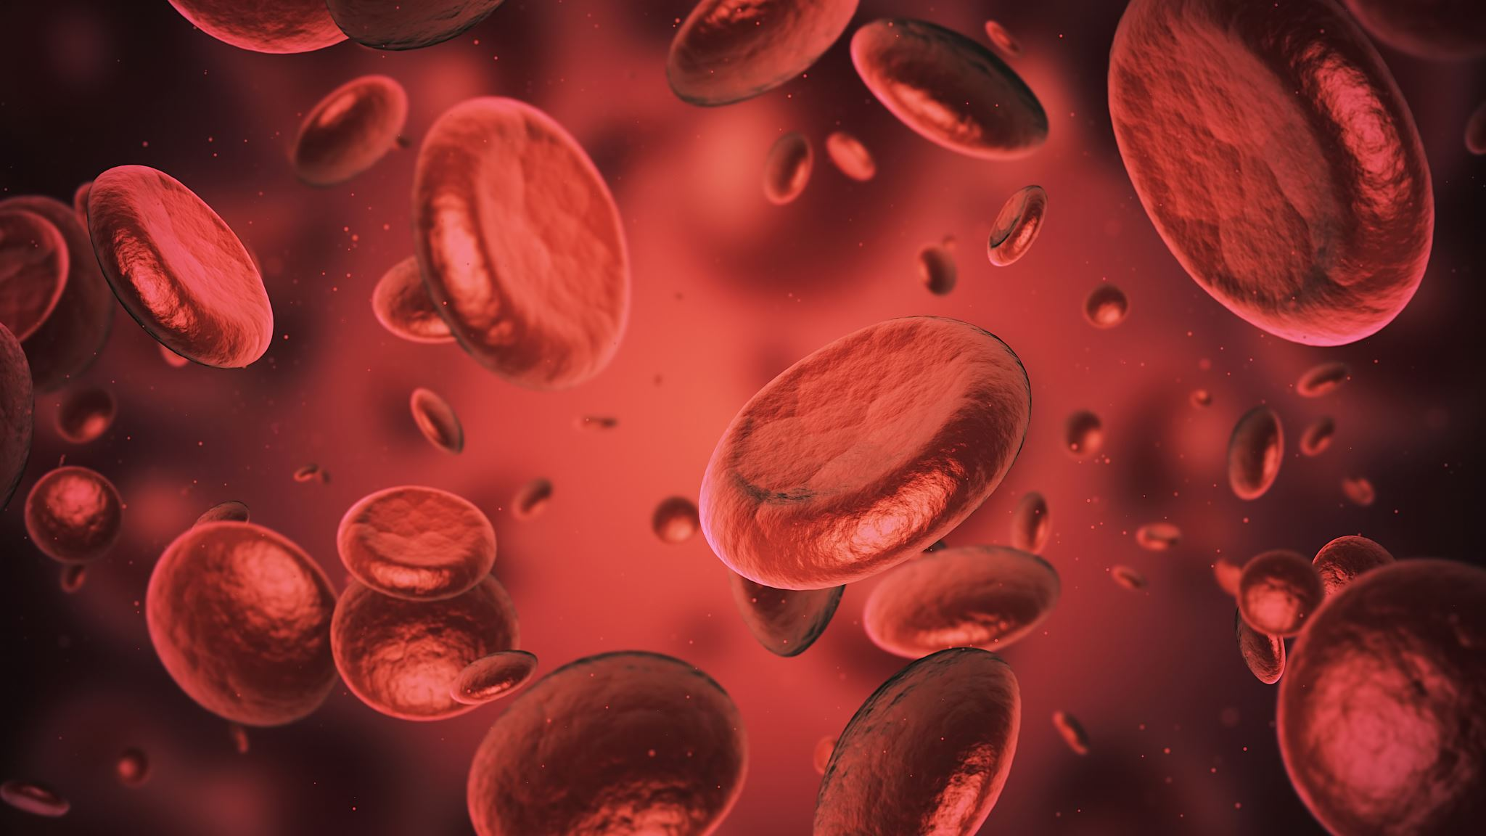
Blood vessels and such

Slide 49
What is the laziest organ in the human body

Slide 50
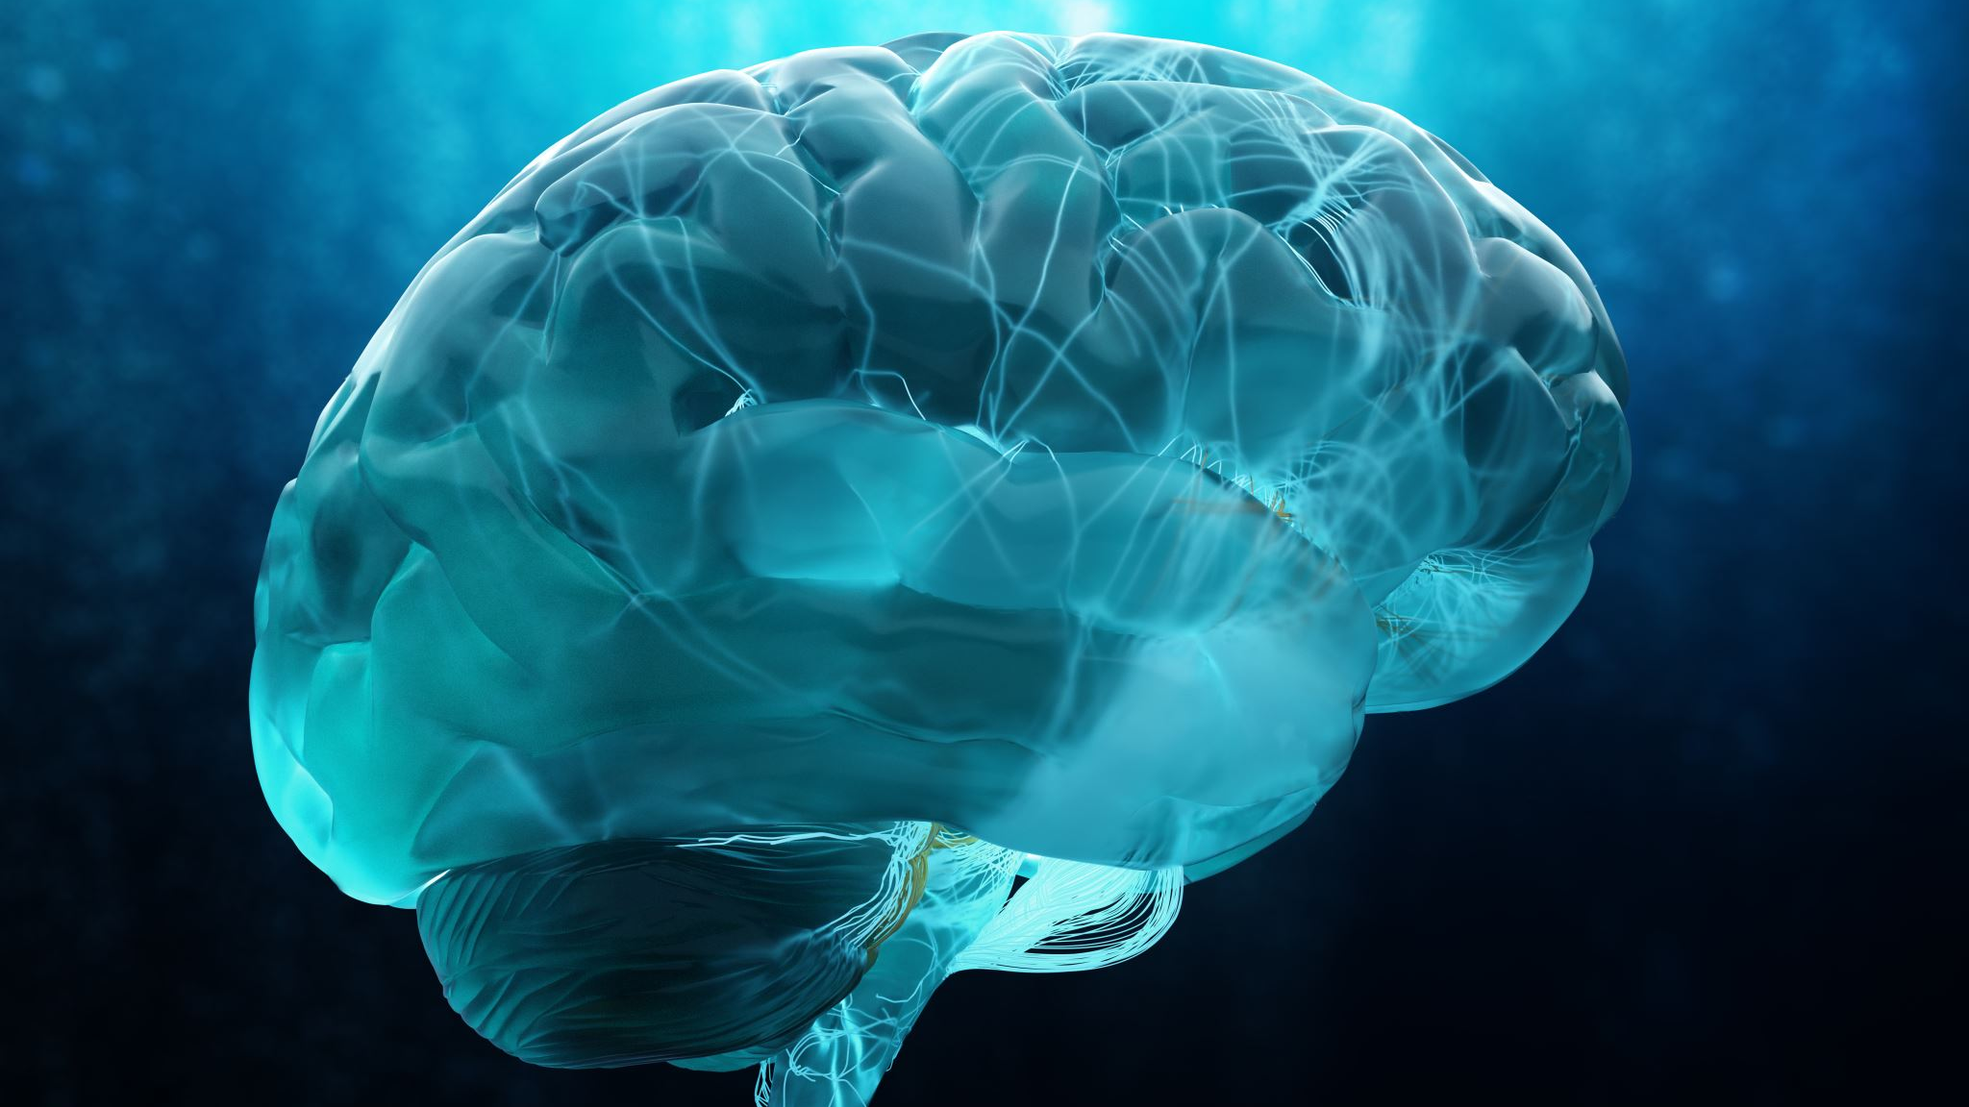
Brain

Slide 51
Power House?

Slide 52
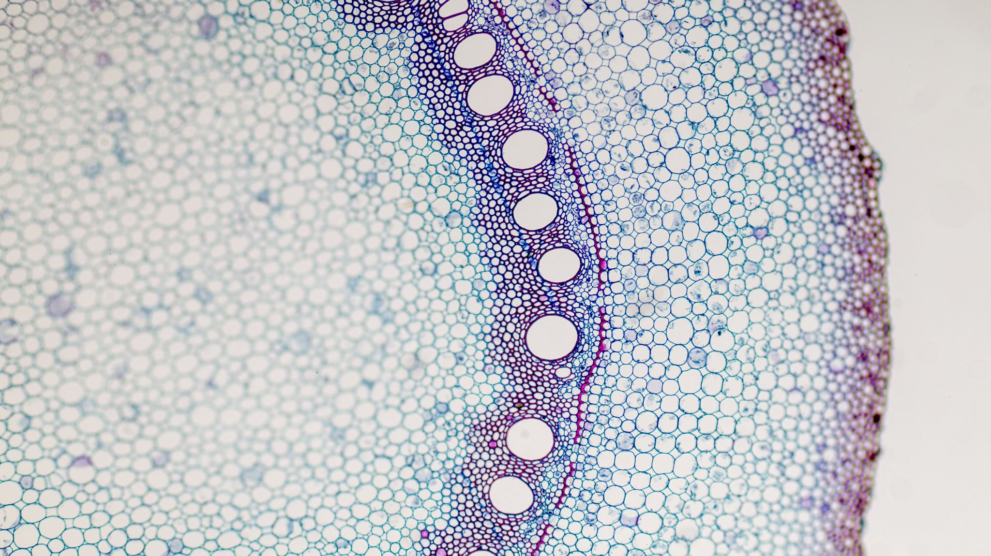
Mitochondria

Slide 53
True or False (explains your answer) a human can 100% survive without a stomach

Slide 54

True

Slide 55
What animal can hold its breath underwater the longest

Slide 56
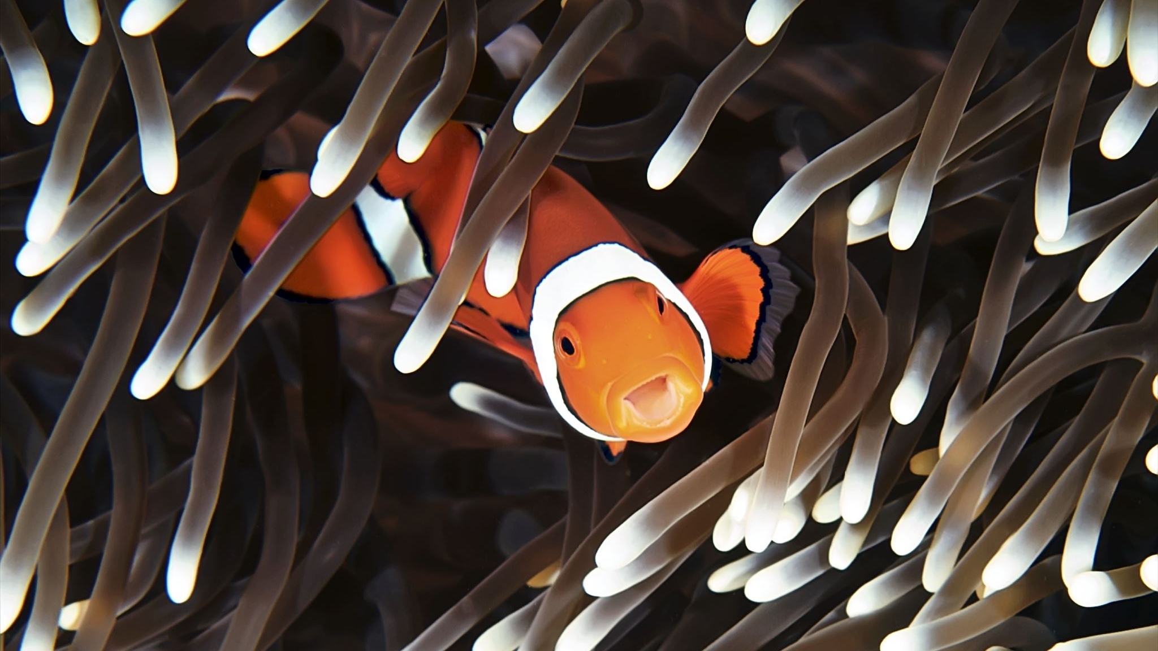
Fish

Slide 57
While some people are born without this those who are born with this usually tend to cut it for hygiene reasons

Slide 58
Hair (not foreskin)

Slide 59
This is a red liquid located inside of your body

Slide 60
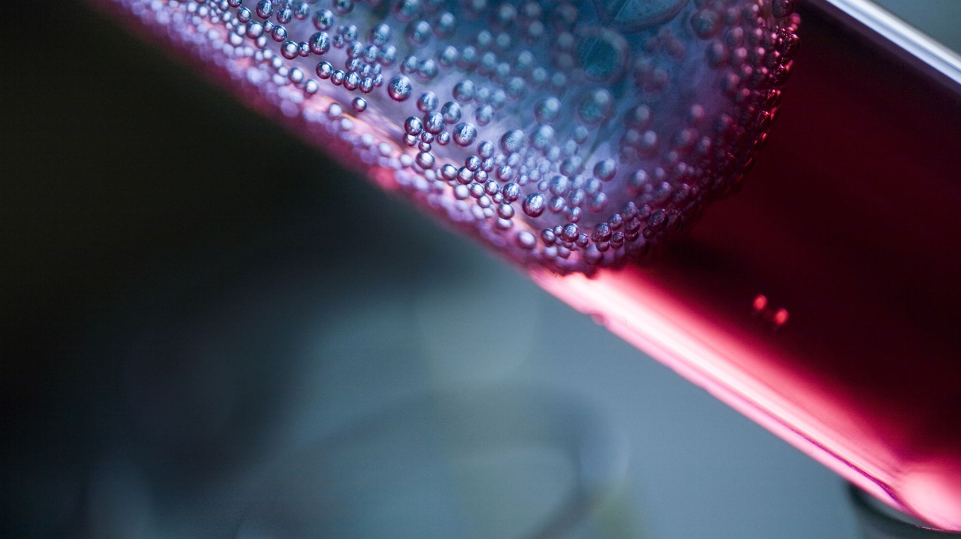
Blood

Slide 61
Name a five headed dragon in yugioh!

Slide 62
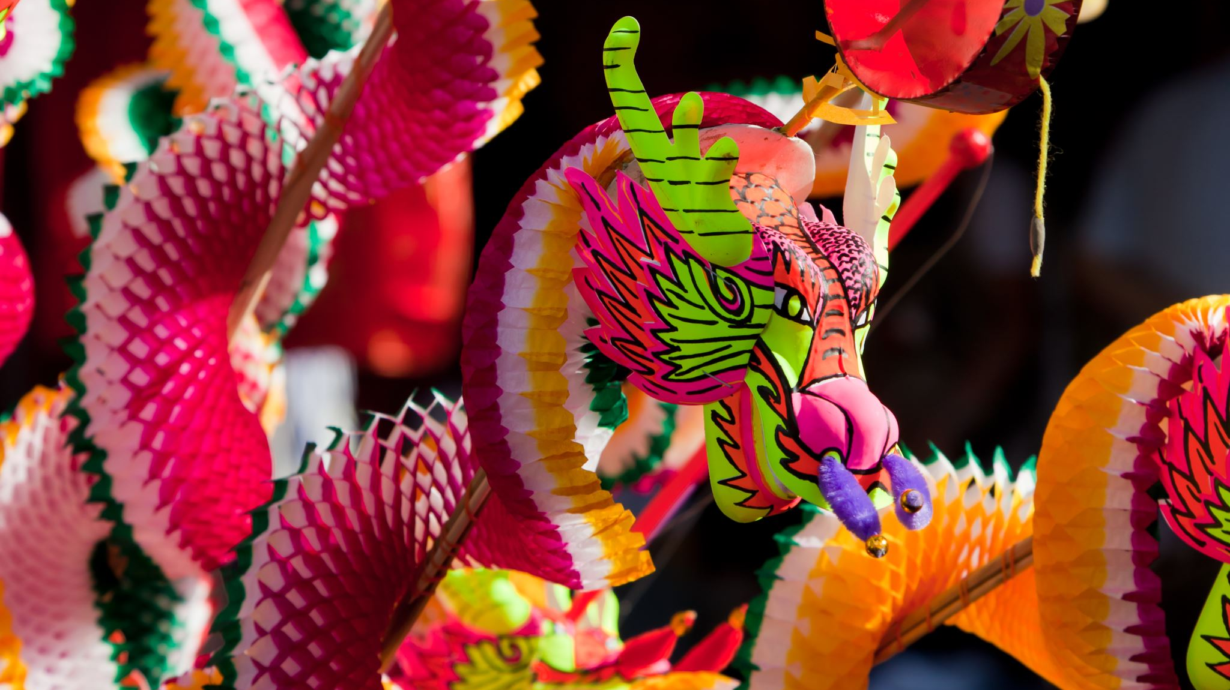
Five headed dragon

Slide 63
This mythological creature is depicted with scales, a lizard like appearance, and in some cases having multiple heads

Slide 64
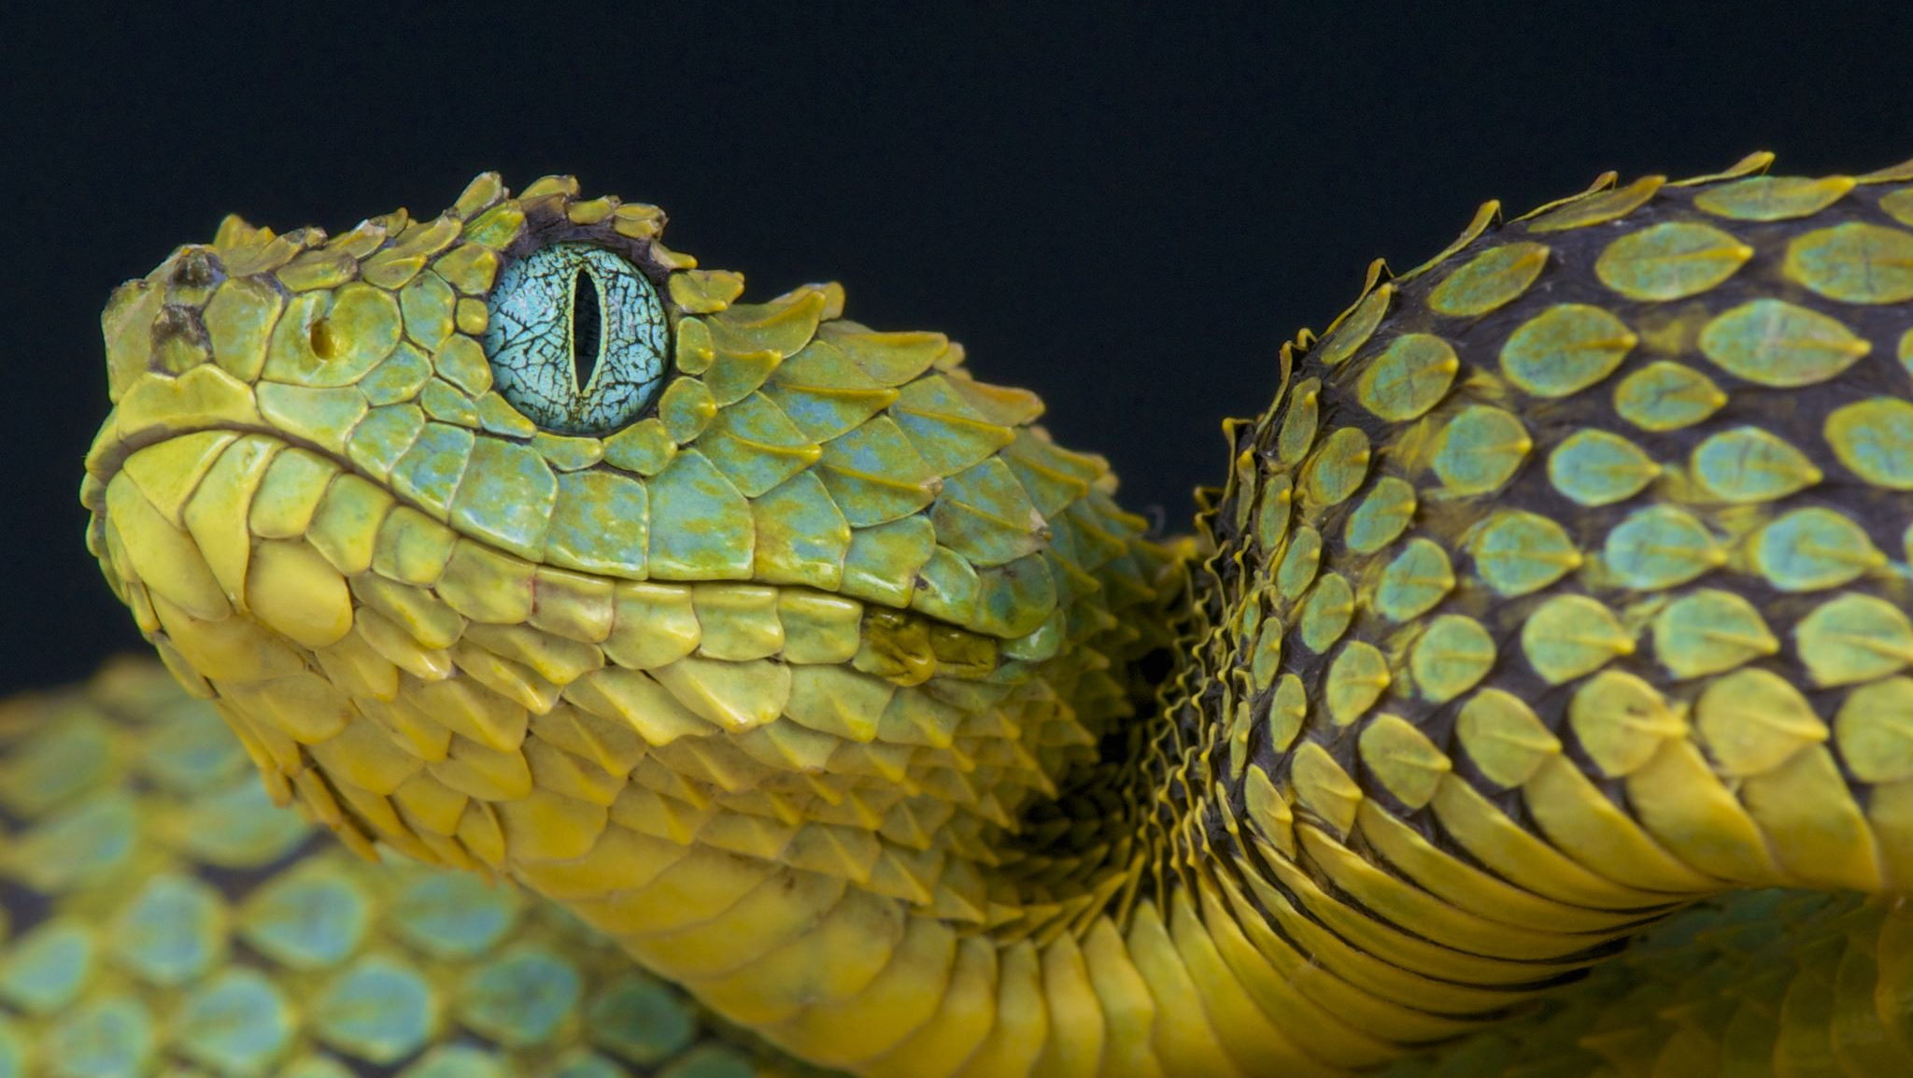
Hydra

Slide 65
This tabletop role playing games has players act out fantasy characters and roll dice

Slide 66
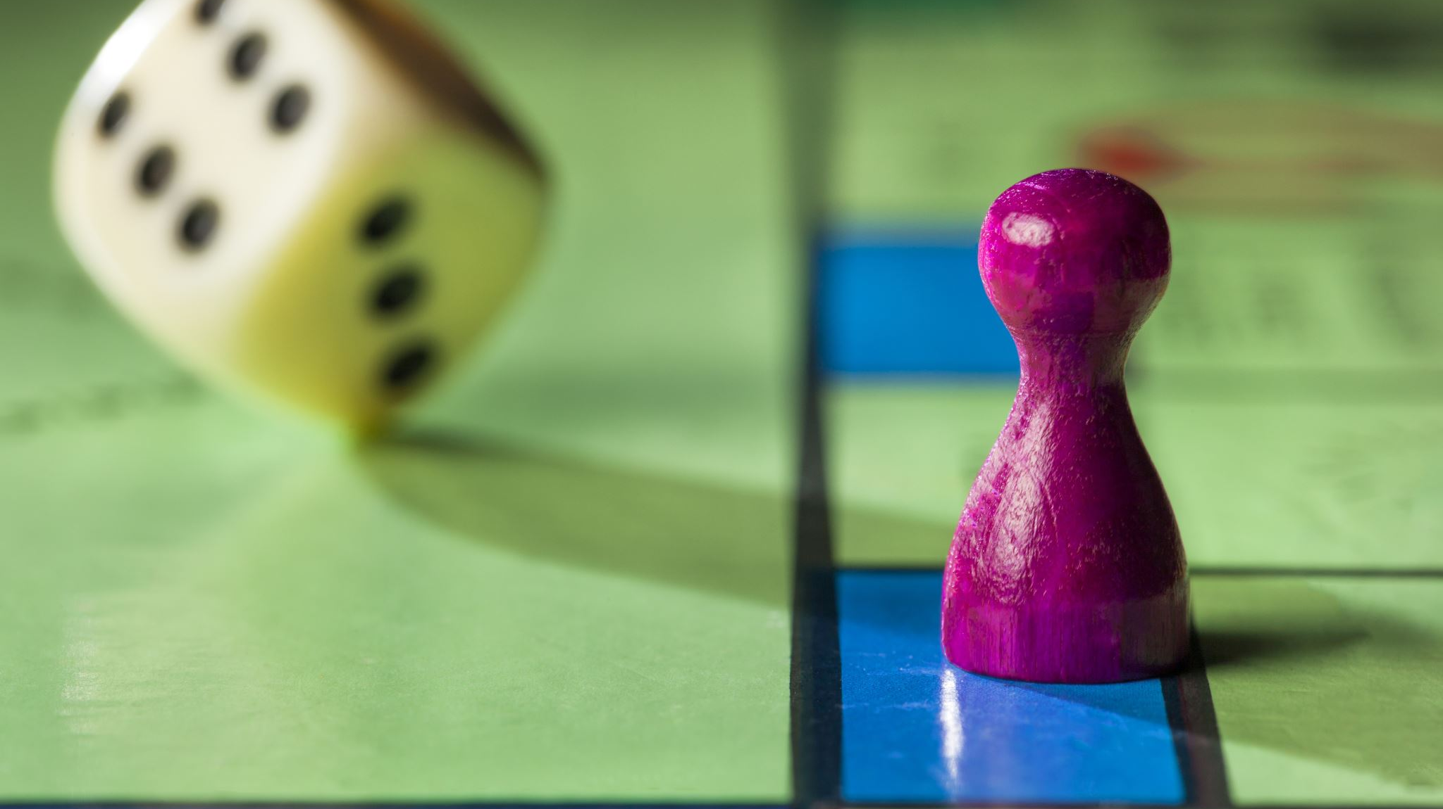
MONOPOLY

Slide 67
A healer a wizard and a tank walk into a bar. What is wrong with this statement?

Slide 68
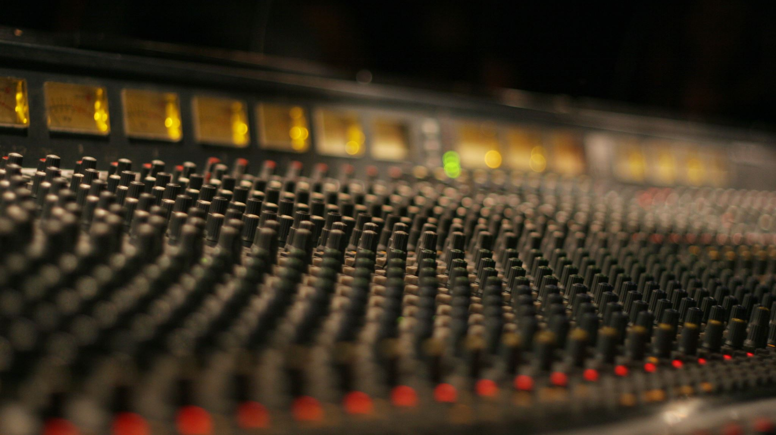
The Tank should enter the bar first

Slide 69
Player 1 casts lightning player 2 casts reflect player 3 exists (exists) who gets hit saif, omar or khalid?

Slide 70
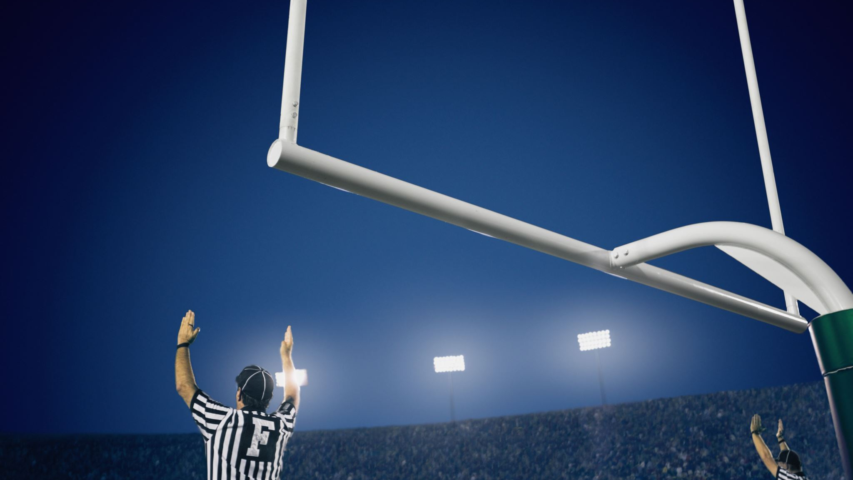
Saif (player1) is correct

Slide 71
How many hammers are there in a War?

Slide 72
40’000

Slide 73
Who is your favourite character

Slide 74

Let the council decide

